Slide 1



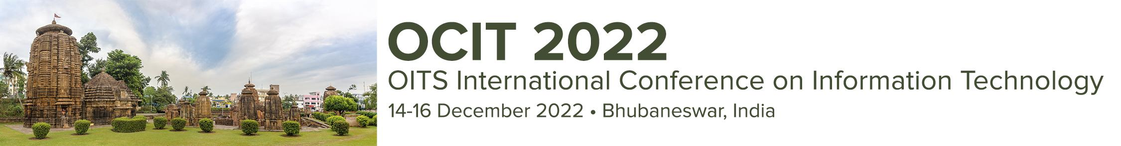
Paper ID : 127
Paper Title: iHELM: An IoT-Based Smart Helmet for Real-time Motorbike Accident Detection and Emergency Healthcare Services
Presenter Name: Dr. Debanjan Das

Slide 2

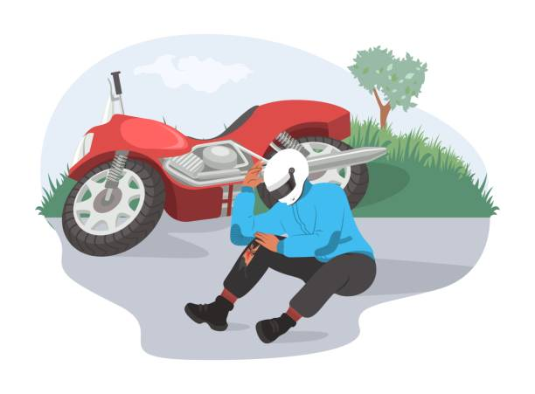

Introduction
For bikers, accidents are a more signiﬁcant concern. Lack of enough safety measures, poor roads, and faulty helmets result in a high probability of disaster.
Most of the deaths occur due to lack of timely medical treatment. Hence, timely and efﬁcient ﬁrst-aid and medical attention becomes necessary in road accidents.

Slide 3
Introduction
With the existing solutions, it is very difficult for bike riders to receive immediate medical attention in case of an accident.
Almost 40% of people who die in road accidents are two-wheeler drivers. Most of the deaths occur due to lack of timely medical treatment.
Most of the existing solutions are neither cost-effective nor they implement any corrective measures for false positives which can cause unnecessary panic in hospitals.

Slide 4
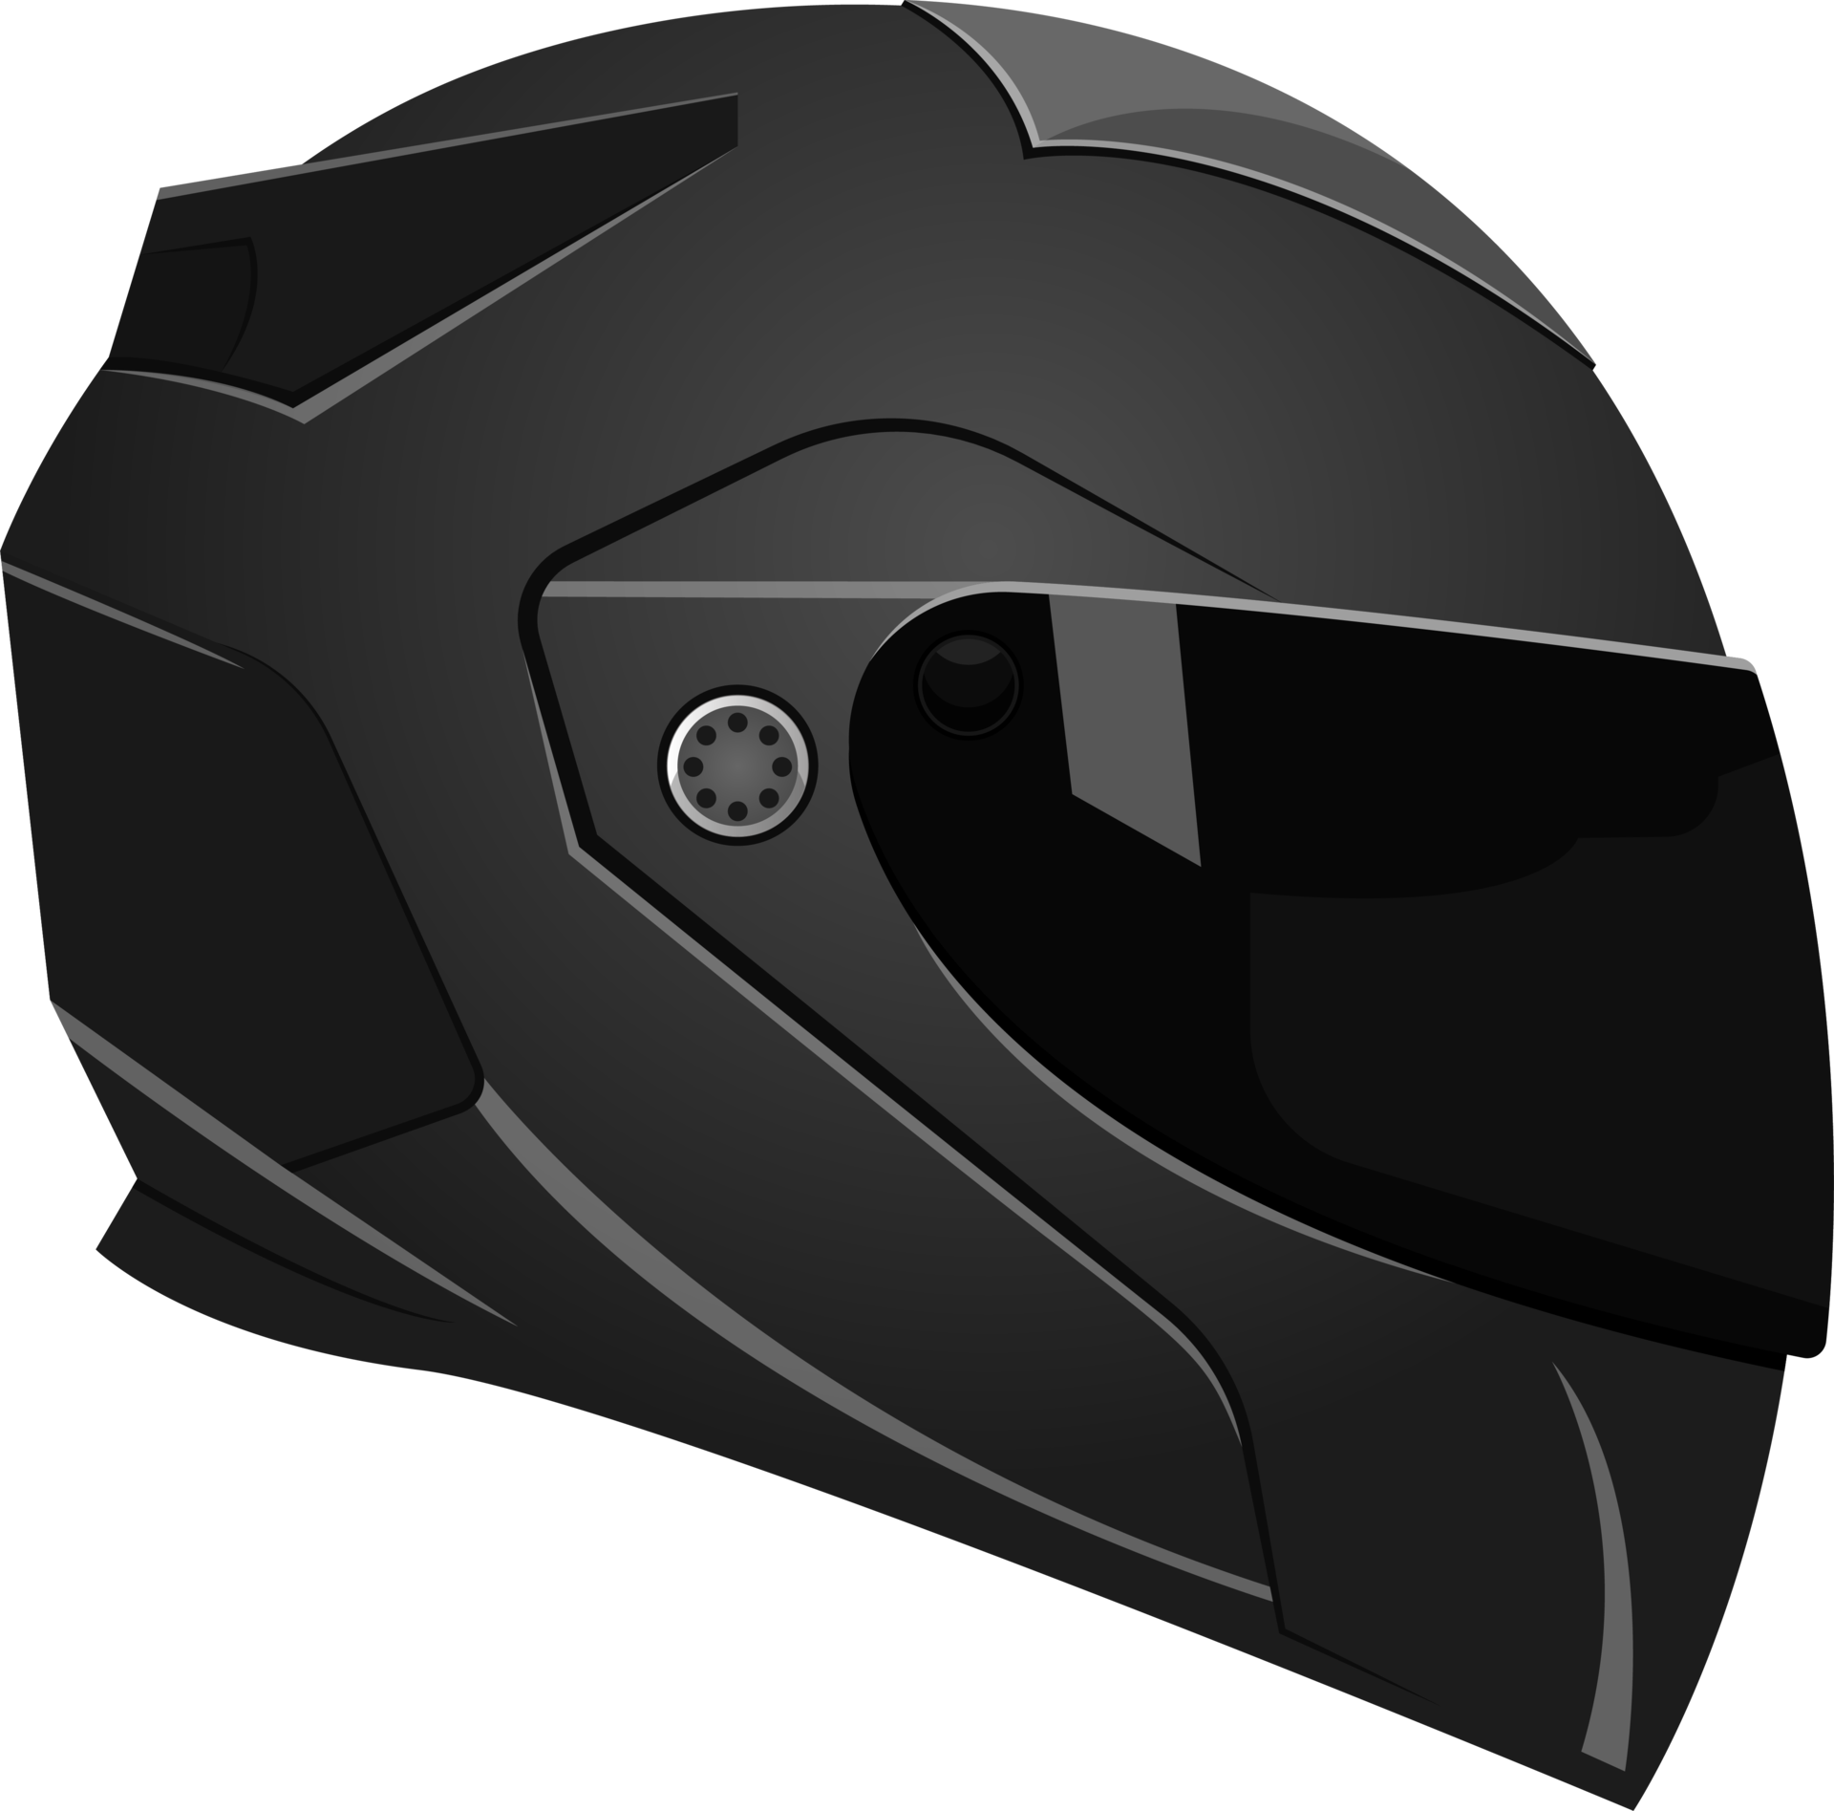
The Solution - iHELM
iHELM provides bikers with an effective, affordable and practical tool to monitor their status and any accident scenario, while also notifying relevant authority in case of an emergency.
iHELM serves to measure the parameters critical for accidents, identify actual accidents, find the geolocation of the driver and communicate
the geo-location with the hospital closest to the injured person in-order to save precious time. The threshold values change dynamically according to the body stature of the biker, using the ML-model to predict the likelihood of the accident and filter out any false positives.

Slide 5
Major Contributions
A real-time practically wearable for accident detection of a biker regardless of his/her location.
Notifying the nearest possible hospital, in the least amount of time delay, of the location of the accidented person.
Filtering out false positives without any complex rule-based algorithms.
Using the practical and real-world application of machine learning algorithms which tend to be the best fit in this case.

Slide 6
Related Works
Name of the solution | Features | Drawbacks
Iot based smart helmet and accident identification system [1] | Accident Detection Practical for bike usage Efficient communication | Doesn’t implement ML for false positives Not cost effective
Konnect: An internet of things (iot) based smart helmet for accident detection and notification [2] | Accident Detection Cloud based for data transfer | False Positives Not cost effective

Slide 7
Related Works
Name of the solution | Features | Drawbacks
An iot-based vehicle accident detection and classification system using sensor fusion [3] | Accident Detection ML based processing of data. | Not practical for bike usage Redundant hardware used.
Iot and cloud based integrated system for accident reporting and vehicular health monitoring [4] | Accident Detection Reliable means of communication in case of emergency | Not for bike usage Doesn’t implement ML for false positive detection.

Slide 8
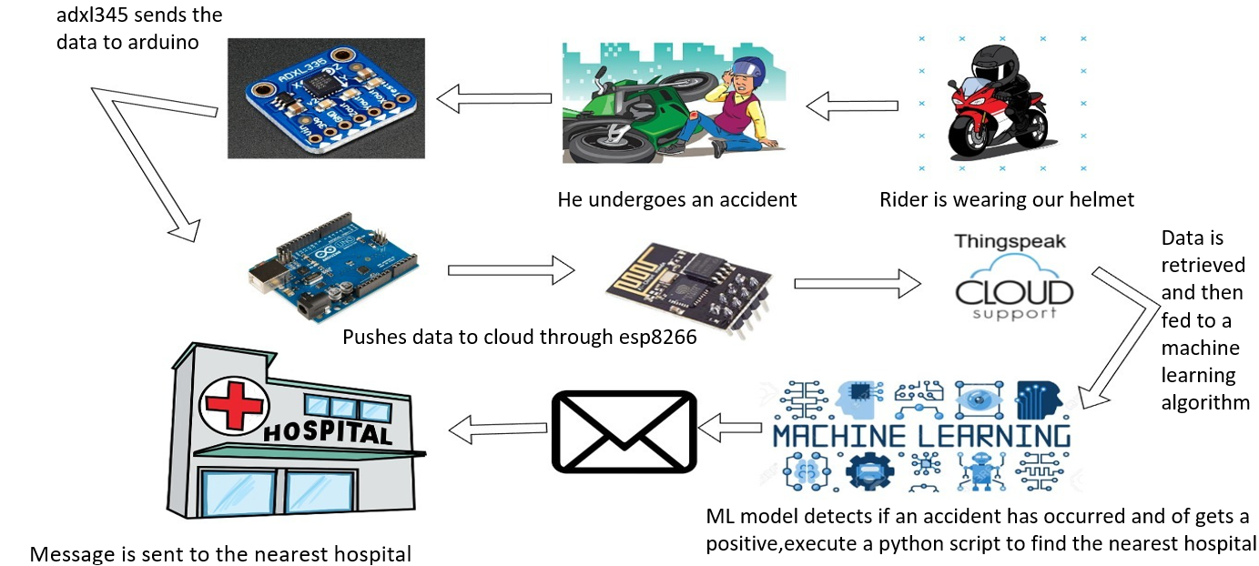
Proposed iHELM Architecture

Slide 9
Architecture Overview
The iHELM system is primarily divided into - Sensor Node, Cloud database, a machine learning algorithm, a database of hospitals and their locations, and finally an API.
The sensor node collects data from an accelerometer and transmits it via an ESP8266 WiFi SOC.
The sensor node collects and logs data(the transmission, depending on the network speed) to the cloud which is ThingSpeak cloud by MathWorks.
Data from the cloud is retrieved via web scraping and fed to ML model for accident detection and handling false positives.
The SOS message is also sent via a python code which makes use of python’s pywhatkit library.

Slide 10
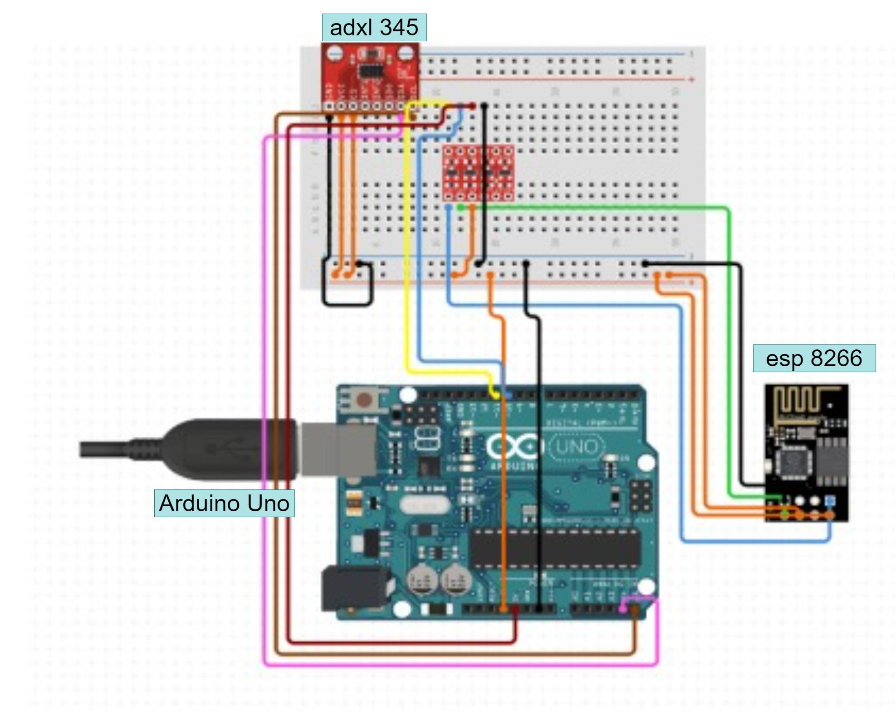
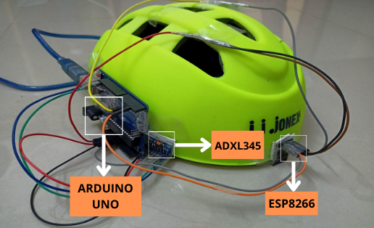
Proposed iHELM Architecture

Slide 11
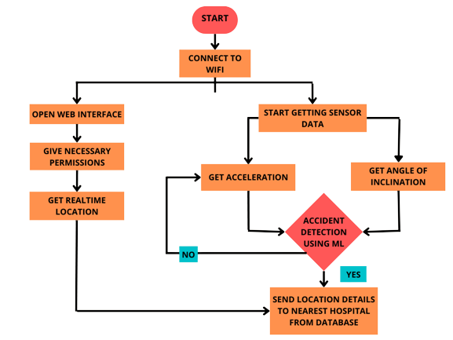
Methodology
Sensor node operation and data transfer: Due to compact and practical model, ADXL345 is utilised to its utmost efficiency, calculating the net acceleration, and tilt along all three axis. Data from the sensor node is transferred via ESP8266 WiFi module to ThingSpeak cloud.
Accident detection: The obtained data is fed to a pre-trained Decision Tree Classifier machine learning model which classifies the condition as an accident or not. Based on the final result SOS message is either sent or not.

Slide 12
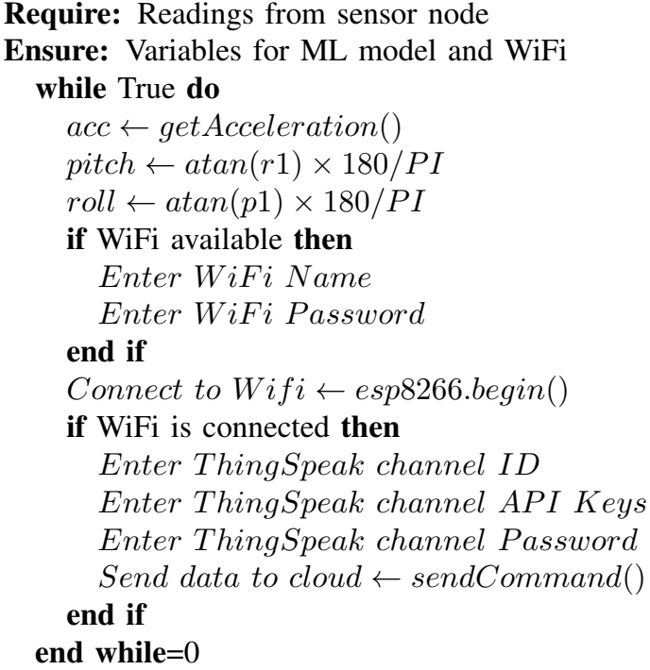
Methodology: Sensor Node Operation
ADXL345 3-axis accelerometer finds the values of acceleration along the x-, y- and z-axis.
From there, we can estimate the net acceleration in g, the roll and the pitch of the vehicle.
The data collected via the sensor is sent to the ThingSpeak cloud of the user via ESP8266 WiFi module.
For every instance of data, the ML model classifies it as an accident or not which increases the efficiency..

Slide 13
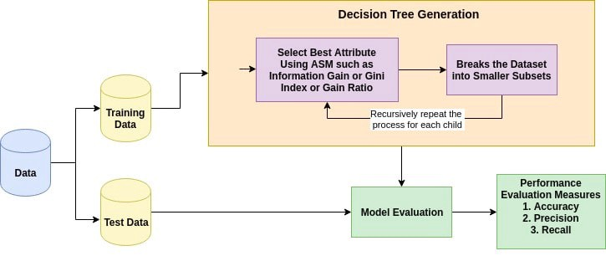
Methodology: Accident Detection
After applying many classifying algorithms, it turned out that Decision Tree Classiﬁer works the best in this case scenario. We achieved an overall accuracy score of around 85%.
This model basically works on the principle of divide and conquer.
Each incoming data is treated as a node and based on the decision of testing it is classiﬁed as a particular category.

Slide 14
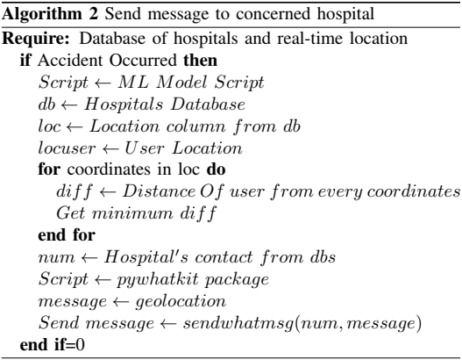
Methodology: Sending the SOS
If an accident is detected then an SOS message is sent via WhatsApp from the user’s phone.
We send the SOS via a python script which utilizes WhatsApp API to send an automated message to the desired hospital without any user intervention.
Location of user is derived from the cloud. We select the hospital nearest to the user from our database to send the SOS.

Slide 15
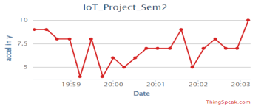
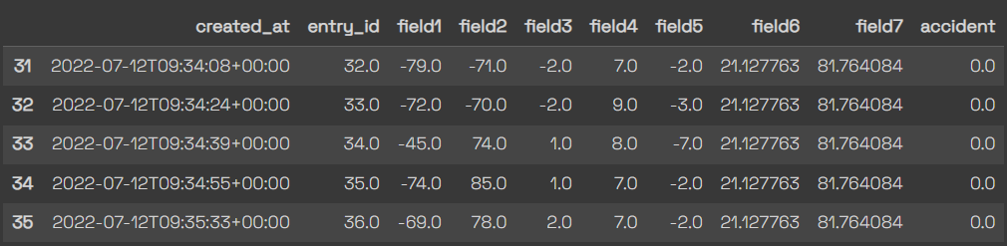
Results: Data Collection
Plot of the data collected from the helmet while the user tested it under duressing conditions. Here, we can easily differentiate normal condition and the extreme condition initiated by the rider.
Dataset retrieved from the ThingSpeak for pre-training and testing our Machine learning classifier.

Slide 16
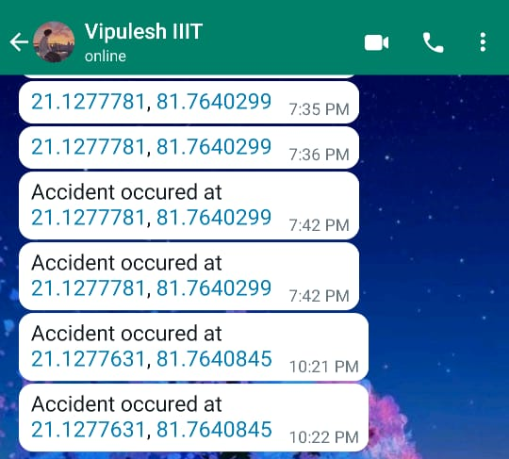
Results: Sending the SOS
Message received by the emergency contact in the case of an accident predicted by the Decision Tree Classifier.
The contact is extracted from a database which stores details of hospitals of a nearby region.
Utilising the automating capabilities of various python modules we can send the SOS message.

Slide 17
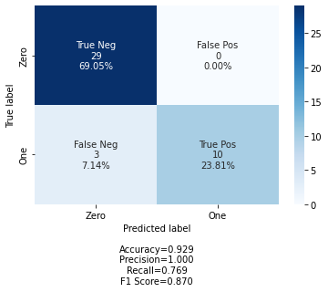
Results: Evaluation of ML model
After collecting the relevant dataset and pre-processing it, we move on to apply our Decision Tree Classiﬁer on the data received.
On passing the training dataset as input, we get 0 or 1 as output for each test case. Here, 0 corresponds to safe and 1 corresponds to accident.
On analyzing our result, we found that most of the false positives were cleared out by this model and its response to the respective precision, accuracy and other judging parameters was quite good, as is shown in the figure.

Slide 18
Conclusion
Most solutions that are in common practice nowadays rely heavily on using traditional rule-based methods which are dependent on readings provided by many sensors integrated in the sensor node. It makes the helmet bulky and quite impractical for daily use. Using rule-based learning methods makes it unable to learn from new data or ﬁlter out false positives effectively.
Our solution has improved upon the traditional approaches by implementing a more practical and comfortable alternative which can be commonly used. By using a machine learning based approach, we are making our model capable of adapting to newer data and even ﬁlter out many false positives without end-user intervention.

Slide 19
References
M. A. Rahman, S. Ahsanuzzaman, I. Rahman, T. Ahmed, and A. Ahsan, “Iot based smart helmet and accident identiﬁcation system,” in 2020 IEEE Region 10 Symposium (TENSYMP). IEEE, 2020, pp. 14–17.
S. Chandran, S. Chandrasekar, and N. E. Elizabeth, “Konnect: An internet of things (iot) based smart helmet for accident detection and notiﬁcation,” in 2016 IEEE Annual India Conference (INDICON). IEEE, 2016, pp. 1–4.
N. Kumar, D. Acharya, and D. Lohani, “An iot-based vehicle accident detection and classiﬁcation system using sensor fusion,” IEEE Internet of Things Journal, vol. 8, no. 2, pp. 869–880, 2020.

Slide 20
References
L. Rupesh, A. Jain, S. Sarda, S. Gupta, S. Sajeesh, and D. Palanisamy, “Iot and cloud based integrated system for accident reporting and vehicular health monitoring,” in 2018 Fourth International Conference on Research in Computational Intelligence and Communication Networks (ICRCICN). IEEE, 2018, pp. 23–26.

Slide 21
THANK YOU

